Slide 1
An Introduction

Slide 2
What is Revision?
What is revision? What does it look like? How do you do it? What works best?
All these are fair questions we hope to answer through this session.

Slide 3
Why Do You Need To Study?
Doing work at home builds on your understanding of what you have done in class and increases confidence
If done regularly it helps move your knowledge and understanding to your long-term memory
Revision (literally "looking again") helps you in class by making sure you have the foundational understanding to progress

Slide 4
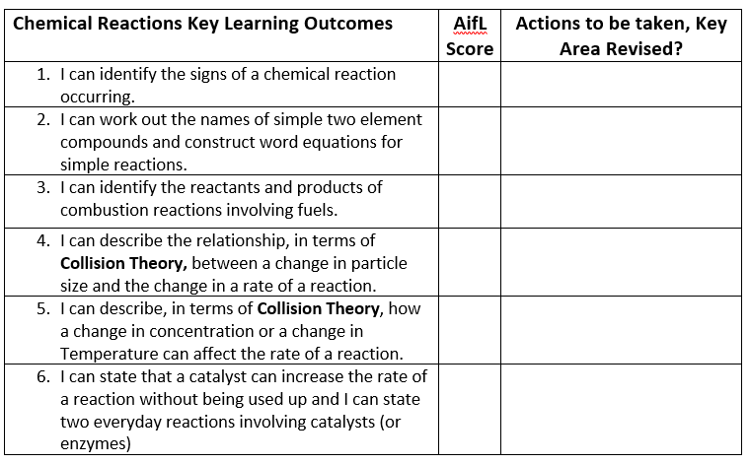
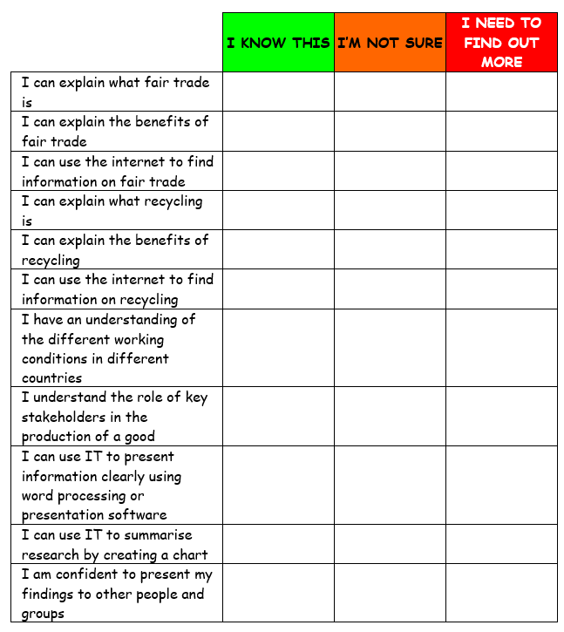
What To Study?
The feedback you get every day in class will give you some idea of areas you feel you need to spend some time on at home.
Your tracking should help you identify the things you need to get better at – these should be the focus for your revision.
You should also ask your teacher for a list of things you need to know for any assessment or piece of work. These success criteria provide you with a clear sense of what you need to know to do well and progress.
Making less progress than expected
Making progress
Progressing well
What is your tracking telling you? Even if you are progressing well what areas can you still improve?

Slide 5
Types of study activity

Slide 6
Retrieval Practice
This technique is where you use other strategies to help you remember (retrieve) facts. This needs to be done regularly and only for a short time each time. Good ways to do this are:
Flashcards
Self-quizzing
Think-Pair-Share
Brain dumps
Most importantly you need to keep going back to older topics. You can’t learn something in August, not read anything about it and then expect to score top marks in June when you are tested!
Task:
Find out how the bullet points on the left can help you study. Decide which one might be best suited to you. Can you explain why?

Slide 7
Brain Dumps
A brain dump is useful to see what you can remember about a topic.
It is more effective if done regularly and after a small number of lessons.
Take a specific time e.g. 7 minutes and write down everything you can remember about the chosen topic e.g impact of an earthquake
Once done you can check what you have written against your checklist/success criteria. Take careful note of anything you have missed (in a different colour) and repeat the brain dump after a small gap of a couple of days

Slide 8
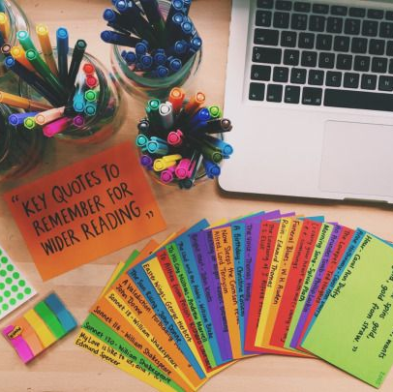
Flash Cards
Flash cards should have a question or prompt on one side
On the other side they should have the answer or key points
Get someone to show you the first side and check your answer
Flashcards are more effective if used regularly. Use the 3 box method on the next slide as a template

Slide 9
Flash Cards – 3 Box Model
If answer is incorrect place card back in Box 1
Box 1
Every day
Box 2
Tuesday and Thursday
Box 3
Friday
If answer is correct move to next box
If answer is correct move to next box

Slide 10
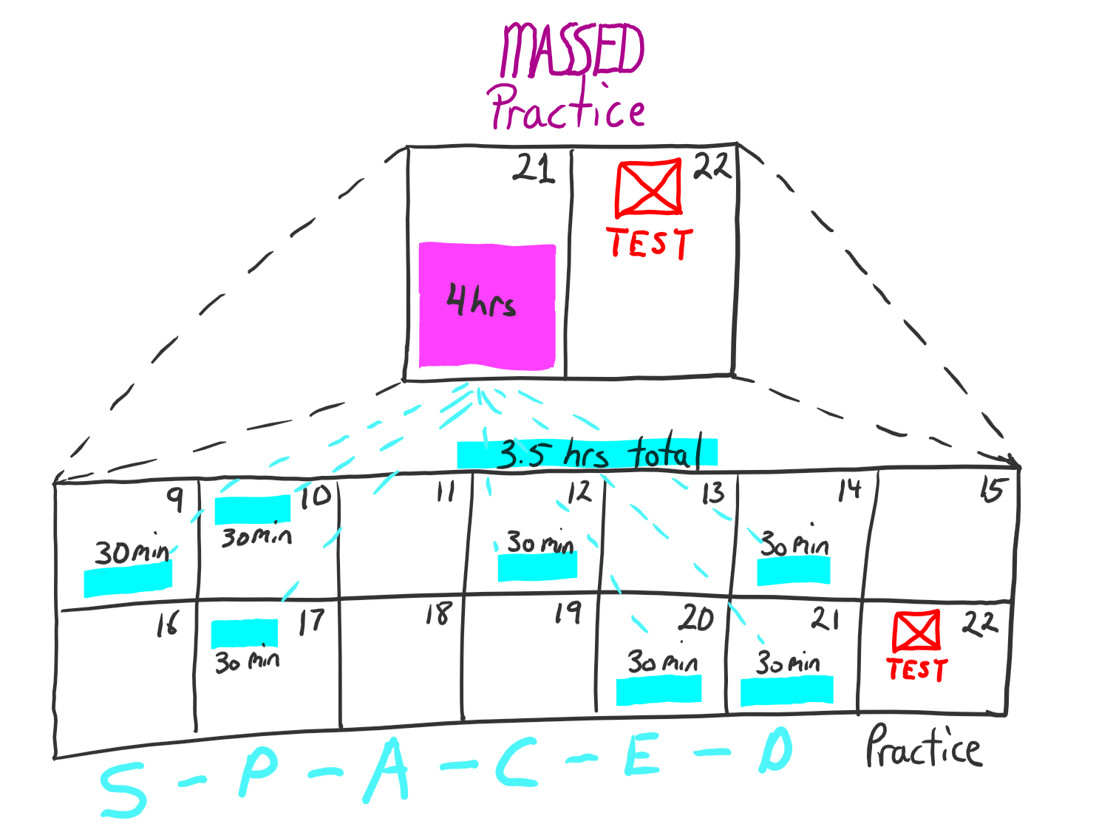
Spacing
This is where you learn a little a lot rather than cramming it in once. This is effective as the forgetting and relearning of chunks of learning allows it to go into your long-term memory.
This can be done alongside ‘interleaving’ where you go between different topics or skills with breaks in between.

Slide 11
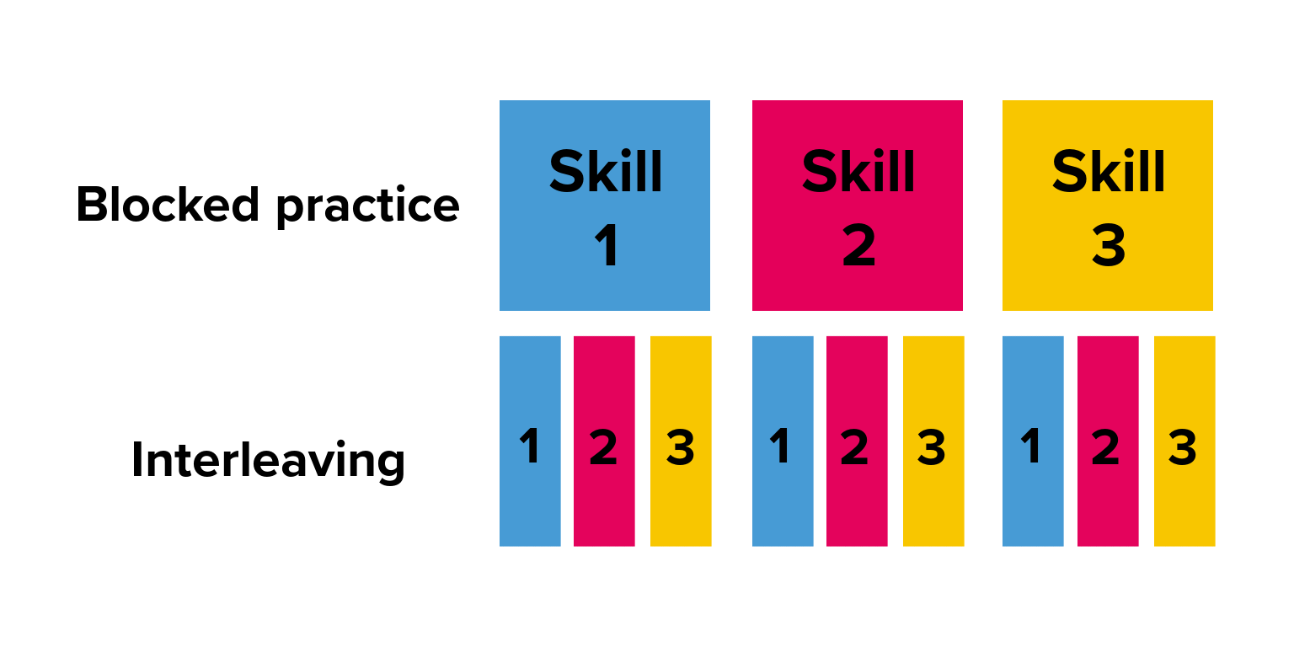
Interleaving
Interleaving is where you revise/practice related skills or knowledge and switch between topics regularly.
This works best when the topics being studied are related in some way such as integration and differentiation in Maths
This works because the first minute or two of each block is spent remembering the rules helping them to enter your longer-term memory

Slide 12
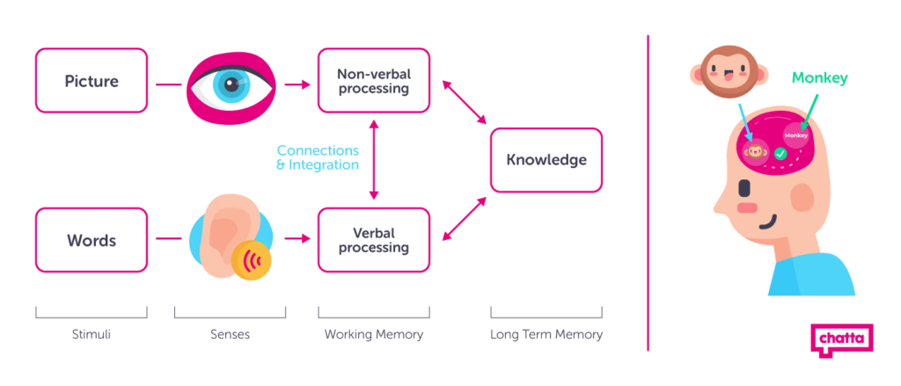
Dual Coding
Dual coding is where you use visual aids along with words.
This is effective because your brain receives information from two channels – auditory and visual. By having words and images you increase the brain's opportunity to take in the information

Slide 13
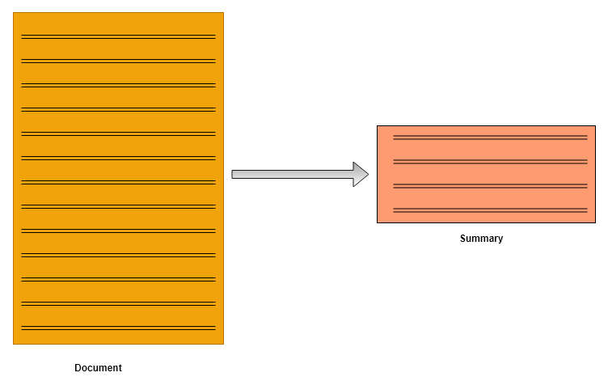
Summarisation
Being able to summarise what you have studied is a really good skill to learn.
After a lesson what are the keys things you should know? What were the success criteria?
Write down the key points and go over them before the next lesson.

Slide 14
Mind Maps
Mind maps are a great way to organise your knowledge. Before you start to do other study techniques think about the main bits of a topic. For example, if I was revising a topic about earthquakes I would have ‘earthquakes’ in the middle and then the branches would have notes on:
How earthquakes happen
Effects of earthquakes
Measuring earthquakes
Preparing for earthquakes
Famous earthquakes
This would allow me organise my notes. If would be helpful to use your revision list from your teacher to plan your mind map.

Slide 15
Mnemonics
Mnemonics are useful when you have a list of things to remember in a particular order.
They are particularly helpful for structuring answers, especially as you move higher up the school and have to write longer answers for more marks. They can give you a good structure for some questions
A mnemonic uses a sentence made of the first letters of the information you need to remember. The example on the left is for remembering the order of the planets.

Slide 16
Practice Questions
Doing practice questions helps you to retrieve your knowledge. It is important to understand:
Command words like explain and describe and what they are asking you to do
How many marks a question is worth and how many things you have to write
For longer answers it is useful to go back and highlight your answer before marking it. You can use one colour for your key points and a second colour for your explanations or examples.
Example:
“Climate change can cause temperatures to get hotter which can stop crops growing and make people starve. Some places will also get more rain that can cause flooding and damage houses. Because of warmer and drier weather, Australia and California have both had big wildfires.”

Slide 17
Highlighting Notes
Reading through your notes is one way to go over what you have learned.
Using highlighters can be helpful to pick out important words that are key in that subject or examples of dates, places or quotes that you need to know.
It can be helpful to use different colours as a key. Maybe each colour relates to one of the key questions.
Highlighting on its own though is low-impact. To make it more effective use it as preparation for another activity such as summarising, creating flash cards or to create a self-quiz

