Slide 1
Deans Community High School
Literacy and Numeracy
Support Evening
Vocabulary and Writing

Slide 2
This Session
-We will look at the school’s focus on vocabulary development
-We will also discuss writing in English and the key aspects of this that we are looking to develop in our pupils

Slide 3
Vocabulary Development
This year, across the school, we have huge focus on explicit vocabulary teaching.
Each subject has identified key words that will be taught to pupils to help improve their understanding of key ideas/concepts in each subject.
In English, our focus is slightly different as we are focussing on tier two words (words that come up across a variety of contexts)

Slide 4
Some examples
S1 – superstition, compassion, abundance
S2 – contrition, conscience, adversity
S3 – coherence, inevitability, enlighten

Slide 5
Why?
1. It improves pupils chances of understanding what they are reading
2. In writing it improves the quality of their vocabulary and, therefore, their descriptions in their writing.

Slide 6
How can you help?
Ask pupils at home what words they have been learning this week
We will also share these words on the school website
Encourage discussions about vocabulary and encourage pupils to take ownership for finding out the meaning of words they don’t understand
https://dictionary.reverso.net/

Slide 7
Writing
In English our main types of writing are:
Creative writing
Personal writing
Persuasive Writing
Report Writing (S1)

Slide 8
We will have a big focus each year on improving the quality of descriptions in creative and personal writing
Show not tell
Using the senses
Use of dialogue

Slide 9
Show not tell
Great writing should SHOW the reader what happens and it should not TELL them
The table on the next slide shows the key difference

Slide 10
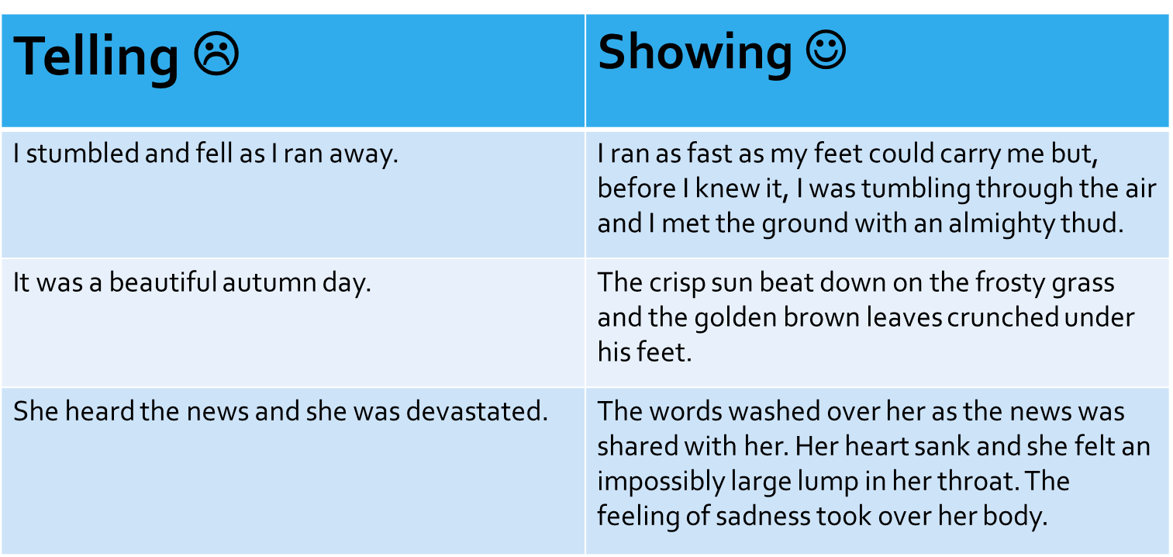

Slide 11
Using the senses
In writing we encourage people to use the senses to effectively describe setting in their writing. Look at the example on the next slide.

Slide 12
The dark cloud seemed to cover the entire house and even fill the insides. The patter of rain could be heard on the rooftops and drops began to seep their way through the holes in the roof. She walked towards the house and the searing cold wind stung her cheeks. It felt like a place where happiness no longer lived. The deafening silence only made her heartbeat seem all the faster to her.

Slide 13
Use of dialogue
A key issue in stories is the use of dialogue. Often pupils use too much of it.
“Hi” said James
“Hey” I replied
“How have you been?” he gently said
“Ok, you? It has been far too long since we saw each other if you ask me” I said with a soft smile.

Slide 14
This dialogue is not needed. It could have been summarised and this would have helped the story flow more effectively.
We quietly greeted each other got through the pleasantries before I worked up the courage to say with a soft smile,
“It has been far too since we have seen each other, James”

Slide 15
How can you help?
Check or ask pupils about their writing to make sure that they are showing and not telling. Use the table on the slide to help
When jotters are at home, check to make sure that they using the senses in descriptions.
Make sure dialogue is being set out properly (a new line for each speaker) and that it is not being used needlessly.

Slide 16
Persuasive Writing
Persuasive writing is when your piece of writing persuades the reader to see a certain point of view (S2 and S3 parents may recall hearing all about sharks)

Slide 17
Persuasive Writing
In their persuasive writing they should be looking to use techniques such as:
Short sentences
Lists
Repetition
Facts/evidence
Questions
Direct address (talking to the reader)

Slide 18
Facts are used throughout (in bold)
Words like we make the involve the reader and this is key
Firstly, we need to realise that sharks do not try to kill or harm us. We need to see that when sharks attack us it is only because we look like injured seals. Sharks attack us from underneath and they think we are their favourite food. They bite us to check what we are but most of the time they leave us alone when we see we are not a seal. In fact, there are many sharks that have never killed a human – a hammerhead is one. People need to stop seeing sharks as a danger and as a killer. They need to change their opinion. Now.
Repetition of the word “need” to emphasise how people really have to change their thinking
Short sentences to plead with the reader to make the change immediately.

Slide 19
Spelling/Punctuation
Of course, this is something that we constantly work on.
We try to encourage self correction strategies (re-reading is key) and use of ICT can be a big help here too (though it doesn’t have all the answers).
Some pupils will require more intensive support (and we can provide that) but the majority need to be empowered and helped to support themselves a little more.

Slide 20
How can you help at home?
Ask pupils what they are working on and if they are aware of their persuasive techniques
Look at their work and see if you can spot them (don’t worry, we don’t expect you to be an expert)
Encourage them to use more of the techniques or rewrite work if you know they are not hitting the brief.
In S3 pupils, ask them what topic they have chosen and, if required, support them with their research.

Slide 21
In summary
Our aim tonight was to give you an insight into what is happening in school
Secondly, we want you to have an idea of how you can open up conversations with pupils at home about what they are doing
Hopefully, this helps you help them ☺

