Slide 1
Reading
Improving Literacy

Slide 2
Why is a focus on reading so important?
The Sims, in which you design and build homes in a blank slate of a neighbourhood, and set about creating ‘Sims’ to live inside them, was released in 2000, and is the bestselling video game of all time. As a teenager, The Sims was my thing. Back then I averaged two or three hours every weekday, and I’d put in a proper sesh at the weekend. It felt wonderful to return home from the incomprehensibly dull monotony of school to a digital world I’d created — a kind of haven of order and control.
My interminable adolescent thirst to be someone else was quenched. I could throw teachers I disliked into swimming pools. I could invent a handsome Sim and command him to kiss an incredibly cool, elegant Sim who, coincidentally, shared my name. I could make a Sim of a pretty, popular girl in my school, and prevent her from falling in love. It was a kind of escapism. Beautiful. Addictive. A little devilish.

Slide 3
Why is a focus on reading so important?
The Sims, in which you design and build homes in a blank slate of a neighbourhood, and set about creating ‘Sims’ to live inside them, was released in 2000, and is the bestselling video game of all time. As a teenager, The Sims was my thing. Back then I averaged two or three hours every weekday, and I’d put in a proper sesh at the weekend. It felt wonderful to return home from the incomprehensibly dull monotony of school to a digital world I’d created — a kind of haven of order and control.
My interminable adolescent thirst to be someone else was quenched. I could throw teachers I disliked into swimming pools. I could invent a handsome Sim and command him to kiss an incredibly cool, elegant Sim who, coincidentally, shared my name. I could make a Sim of a pretty, popular girl in my school, and prevent her from falling in love. It was a kind of escapism. Beautiful. Addictive. A little devilish.

Slide 4
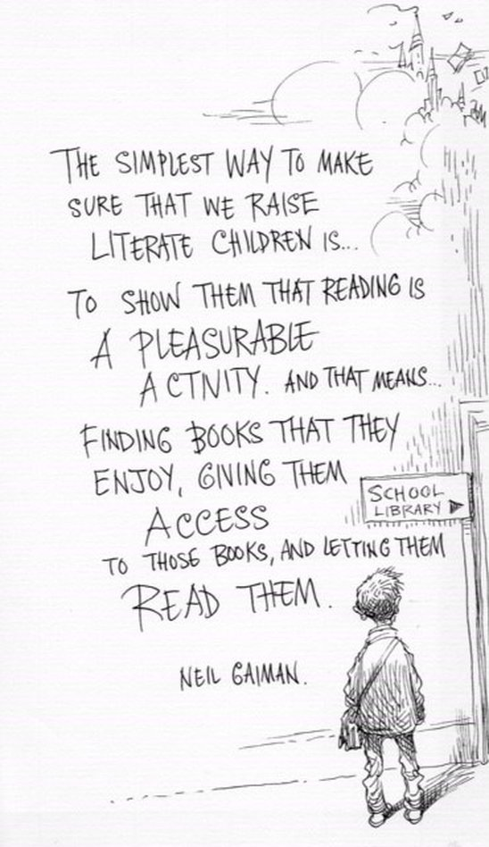
So, what are we doing to help the pupils at Deans?
Vocabulary work
Accelerated Reader
Reciprocal Reading Strategies
Ambitious text selection
Positive ethos around reading

Slide 5
Accelerated Reader

Slide 6
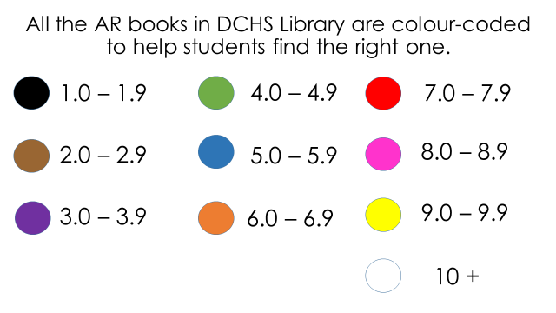
How does AR Work?
After completing a STAR reader test pupils are given a range of colours which match their current reading age.
A new STAR test takes place at regular intervals, so students can see improvements in their reading ability, but also choose more challenging books.
Designated library period each week in English to read, discuss and assess their progress

Slide 7
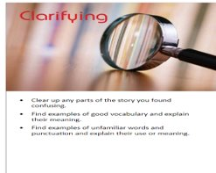
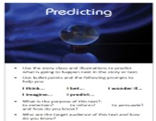
Reciprocal Reading Strategies

Slide 8
How can I help at home?
Reciprocal Reading Approach!:
"What could happen next? Why"
Who, What, Where, Why, When?
Summarise the main events for me
What is the most important part of the story?

Slide 9
Ask questions such as...
Who is your favorite character?
Where is the book set?
What is the most interesting part of the story so far?
Why don't you like the story?
These questions are especially useful for pupils who have Dyslexia or ADHD and may prefer talking about a story to reading it

Slide 10
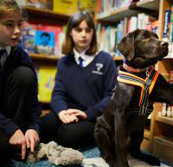
Read along...
Reading with your child - It doesn’t matter what it is – if you’re cooking, could they read the recipe? If you’re watching TV, can they read out the listings?
Your child reading to a younger sibling
Your child reading to a pet, this sounds mad but trust us it helps!

Slide 11
Create a positive reading environment ...
Give books as presents
Let them choose what they are interested in – there is no right or wrong type of book – reading is reading!
Don’t panic if your child reads the same book over and over again. Let’s be honest - we’ve all done it!
Avoid using negative phrasing around reading – even if it's "don't be like me"
Encourage connecting reading to subjects that are relevant to them. For example, if your child is a reluctant reader who wants to work with animals, make it clear how important reading will be to learn more about veterinary science.

Slide 12
Check what they are reading...
•It’s not just books from our library that students can read, they can read books from home and take quizzes on them!
•You can use ARBookFind.co.uk to check whether your child’s current book is on Accelerated Reader.
OR your child can check with their teacher or school librarian

Slide 13
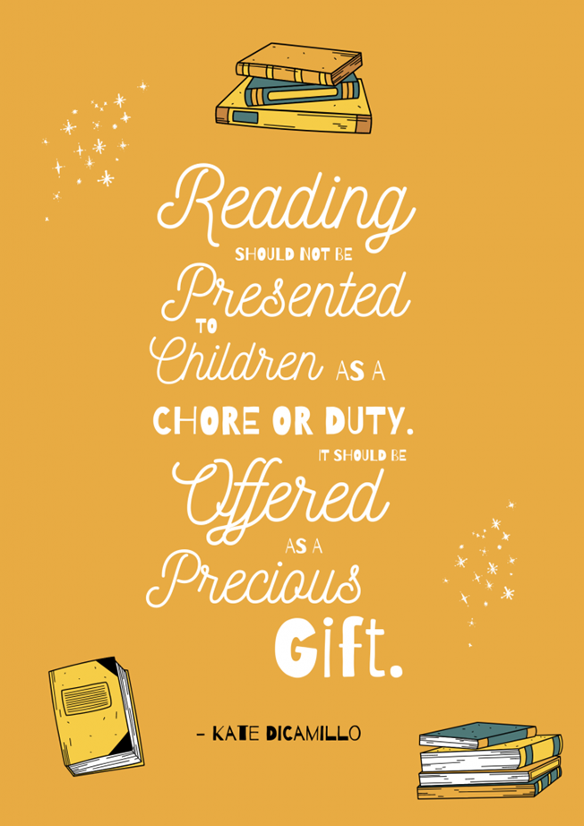
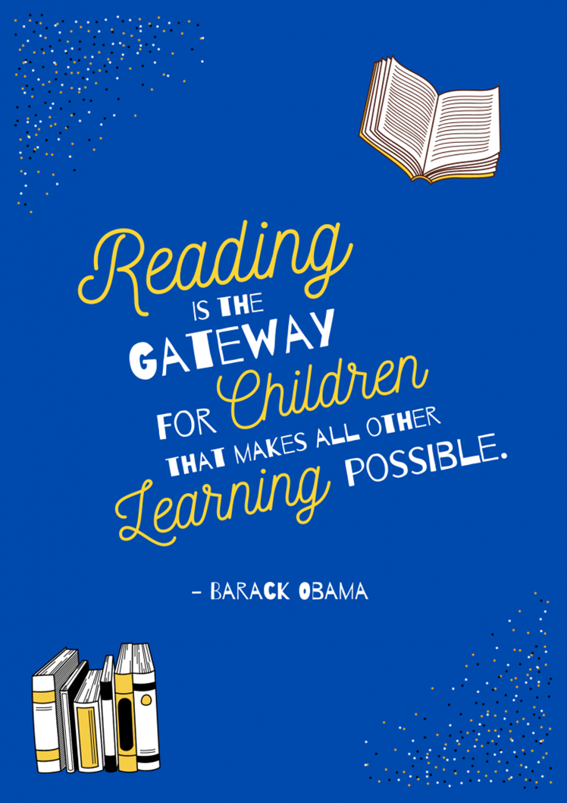
Any Questions?

